Slide 1
Builder Design Pattern
Desai Nitesh:240160510009
Parmar Milan:240160510031

Slide 2
Problem
There are so many parameters to be passed inside the constructor that it becomes difficult for the user to pass all the parameters or it becomes difficult to remember order
There are some parameters that are required and some that are not required, but user does not need all parameter.so many new constructors are being created accordingly.
When creating new constructors, some constructors have the same number of parameters and data type, which creates problems.
Code:1
public class student {
public student(int rolnumber,String firstname,String lastname,String fathername,long phonenumber,String emailid,String course,String sem)
{
}
}

Slide 3
2:
public class student {
public student(int rolnumber,String firstname)
{
}
public student(int rolnumber,String firstname,String lastname)
{
}
public student(int rolnumber,String firstname,String fathername)
{
}
public student(int rolnumber,String firstname,long phonenumber)
{
}
public student(int rolnumber,String firstname,String emailid)
{
} }

Slide 4
Solution
Replaces a single, bloated constructor with a Builder class that allows step-by-step construction using setter-like methods
The Builder class separates required and optional parameters. Required ones can be enforced in the constructor or build() method, while optional ones are set via optional method calls.
Replaces all constructor overloads with a single Builder class, where each parameter is explicitly named via method calls, avoiding type-based ambiguity

Slide 5
Intent
The Builder pattern is used to construct complex objects step by step. It allows creating different representations of an object using the same construction process.

Slide 6
Structure Diagram
Director
Builder
Construct()
buildpart()
getresult()
ConcreteBuilder
Product
buildpart()
getresult()

Slide 7
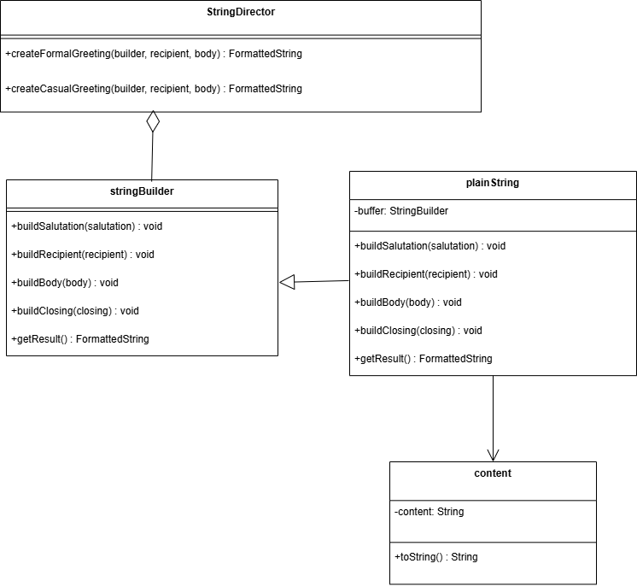
Class Diagram

Slide 8
Role of Participants
Builder
Specifies an abstract interface for creating parts of the product object. It defines the steps or methods needed to construct the product, providing a blueprint that concrete builders must follow.
ConcreteBuilder
Implements the Builder interface to construct and assemble parts of the product. Handles the specifics of how the product is built, encapsulating the construction logic and internal representation.
Director
Constructs the product by directing the Builder through a predefined sequence of steps.

Slide 9
Product
It’s the end result of the builder’s work, assembled from the parts specified by the Director.

Slide 10
Consequences
Advantages
Separate the construction of a complex object from its representation so that the same construction process can create different representations.
The stringDirector (Director) encapsulates the construction logic, making it reusable and consistent across different builders.
The pattern allows you to add new representations (e.g., an HTML string) without changing the construction process.
The pattern supports incremental construction, which is useful for complex objects with many parts.
The FormattedString (Product) is decoupled from how it’s built, making the system more maintainable.

Slide 11
Consequences
Disadvantages
Builder Pattern requires multiple classes, which adds complexity and more code compared to a simpler approach
The step-by-step construction process can introduce a slight performance overhead compared to direct construction.
The stringDirector(Director) is tightly coupled to the stringBuilder interface, which can limit flexibility if the interface changes
pattern can be hard to understand and might be misused for simple tasks.
Builder Pattern assumes a fixed set of construction steps, making it harder to handle optional or conditional steps without modifying the Director or Builder.

Slide 12
References
Intent: geeksforgeeks
Motivation: grok3
Structure Diagram:wikipedia
Class Diagram: geeksforgeeks
Role of Participants : GangOfFour Book
Consequences: grok3

